Slide 1
Advanced HTML

Slide 2
Learning Outcomes
By the end of the day students should be able to:
Demonstrate the use of the <img> tag as well as setting images as backgrounds
Demonstrate the usage of lists
Demonstrate the usage of tables
Build a functioning HTML form with various inputs

Slide 3
1.
Images
Images help increase the aesthetic appeal and design of your website

Slide 4
Image syntax
Images require the src attribute
Images should have the alt attribute
The width and height attribute are useful to set the size (but can be done through CSS)

Slide 5
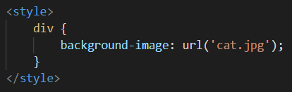
Images as a background
Images can be set as a background of an element using CSS

Slide 6
Try it yourself
Make an image pointing to the supplied image with width 500 and height 500

Slide 7
2.
HTML Lists
Lists are useful for listing things and even creating menus and navigation bars

Slide 8
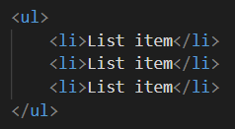
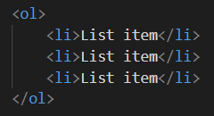
Lists
You get three lists types: ordered- and unordered lists and description lists
Notes:
Ordered lists uses a sequence to indicate the order of list elements. Unordered lists uses a defined symbol such as a bullet to list elements in no designated order. Description lists uses indents to list elements with their children.

Slide 9

Unordered lists
Defined by the <li> nested inside a <ul> tag
Notes:
An unordered list can be created with the <ul> tag and the items inside the list can be created by using the <li> tag.

Slide 10

Ordered lists
Defined by the <li> nested inside a <ol> tag
Notes:
Ordered lists are created with the <ol> tag and each item inside are created with the <li> tag.

Slide 11
Ordered lists
Ordered lists have a type attribute that allows you to change the counting system
type="1" - numbers (default)
type="A" - uppercase letters
type="a" - lowercase letters
type="I" - uppercase roman numerals
type="i" - lowercase roman numerals
Notes:
It is possible to easily change the type of numeral. (counting system) This is done by using the type attribute.

Slide 12
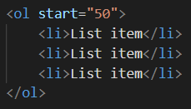

Ordered lists
Ordered lists have a start attribute, this allows you to control where the list should start counting
Notes:
It is possible to change the start of the sequence by using the start attribute. This well set what the number of the first element will be. This has to be set with a number no matter which counting system the ordered list is using.

Slide 13
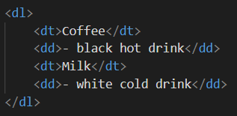
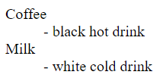
Description lists
Description lists allows you to add descriptions to each item
Notes:
A description list can be created using the <dl> tag consists of name-value groups, where the name is given with the <dt> element and the value is given in the <dd> element.You can have more than one name and more than one value for the name-value groups. This means you can group names (<dt>) and values (<dd>).

Slide 14
3.
HTML tables
Tables are useful for structuring data

Slide 15
Table syntax
Tables are defined by the <table> tag
Each row is defined with <tr>
Inside each row, table headers are defined by <th> and each data cell is defined by <td>
Notes:
Tables are a handy way of displaying tabular data such as text, images, links, etc. Tables are two dimensional with rows and columns of cells.

Slide 16
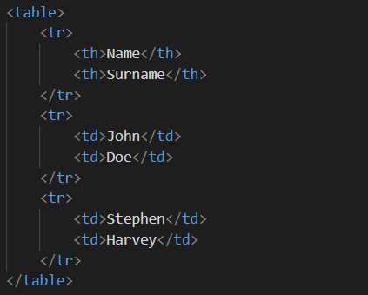
Place your screenshot here
Example of a table
Tables are useful for displaying data
Notes:
<table>
Opens the table. Every element of the table should be inside this tag.
<tr>
Defines a single row in the table.
<th>
This is a tabular header. This creates a heading on the table that you can use to define headings.
<td>
This is tabular data. This creates a single cell that you can put anything inside.

Slide 17
colspan and rowspan attributes
The colspan attribute is used to allow a table cell to span multiple cell spacings
The rowspan attribute allows a table cell to span multiple rows
Both are defined as value=”number”
Notes:
It is possible to set a table cell to span either multiple columns, or multiple rows. This uses the rowspan or colspan attribute. Both have to be non-negative numbers. A rowspan and colspan shouldn’t overlap as this isn’t valid HTML!

Slide 18
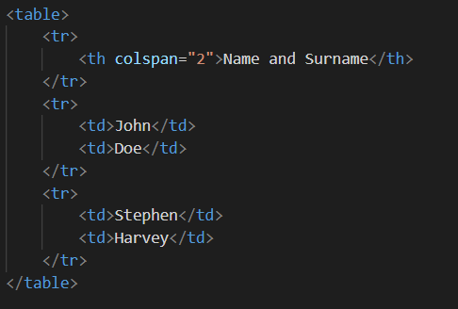
Place your screenshot here
Example of a colspan
The colspan attribute has a lot of use cases

Slide 19
4.
HTML forms
Forms are a crucial part of most websites

Slide 20
Forms
Forms are used to submit any data to a website.
Some examples of forms: a sign up form, a login page, even a search bar is a form!
Forms consists of input elements
Forms work by submitting a request with data to the web server.
Notes:
Forms are used to submit data to a website. They send a HTTP request to the server, that the server responds on. This can be done by sending it either in a secure package, or by sending the request through the URL. These are the two ways requests work when submitting a form.

Slide 21
Requests
You get 2 different kind of requests but for now we’ll cover get and post
post - useful to submit sensitive and large amounts of data
get - useful for a search bar or something similar
Notes:
Forms always submits the data as key-value pairs. The name of each input element is the key and the value of each input element is the value of the data that is going to be submitted. More on these in the Django module.
POST
POST requests are used to submit secure and sensitive data. It’s sent as a package to the server. This is most commonly used when handling any sensitive data. (login forms, sign up forms, etc)
GET
GET requests are submitted through the URL of the request. This means that the data you submit with a GET request is not secure at all. This is most commonly used in search forms or any forms where the data doesn’t have to be secure. The reason why GET is considered insecure is because anyone can read the data submitted by GET because anyone can read the URL.

Slide 22
The <input> tag
<input> tags are used to build the form’s input areas as well as the submit button
You get a few different kind of inputs which we’ll see in a bit
Notes:
A commonly used element in forms is the input element. The display and functionality changes based on the type of the input.

Slide 23
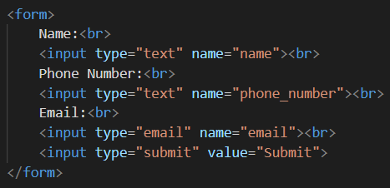
Place your screenshot here
Example of a form
Forms are used to submit data to websites

Slide 24
<input> attributes
<input> tags have a few attributes which are crucial to make them function correctly
type - sets the type of input
name - sets the name of the name-value pair
value - sets a pre-populated value
readonly - sets the input to readonly

Slide 25

type
<input> has a lot of different types. It’s easier to look up which type is best for the occasion rather than trying to remember them all!
A few common ones are “text”, “email”, “submit”

Slide 26
name
The name attribute is crucial in order to submit the data. It sets the name in the name-value pair that the form submits.
The name as set in the form is what the web server will receive and use
We’ll cover how these function when you get to the django module

Slide 27
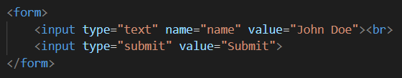

value
The value attribute pre-populates data on forms
This is useful for preserving data when the form is submitted with an error
Notes:
Value is used to specify the initial value. This is used to pre-populate data in a form, or to preserve data in a form after submitting it with an error.

Slide 28
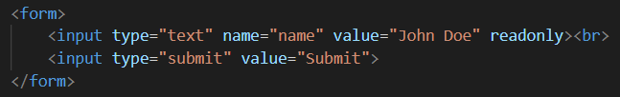
readonly
The readonly attributes is an attribute without a value, you just set it
It’s useful for disabling certain parts of forms
Notes:
Readonly is an attribute that changes the input field to readonly. (can’t be changed)
These aren’t all of the attributes! There are more...

Slide 29
Form attributes
The form itself requires a few attributes to function correctly
action - where the request should be submitted
method - how the request should be submitted
Notes:
The action attribute sets the URL of the website that the form will be submitting its data to. This needs to be present for the form to actually submit its data somewhere. The given URL can be explicit or relative. The method attribute specifies which HTTP method (GET or POST) to use when submitting the data.

Slide 30

Action
The action tells the form where to submit the data
The action should be a valid location
The location works the same as with href in anchor tags

Slide 31
thanks!
Exercise time!

